Slide 1
Marketing
Course ICT Entrepreneurship
Prof. Dr. Sjaak Brinkkemper Dr. Gerard Wagenaar

Slide 2
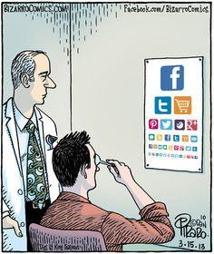
Contents
Marketing Basics
Marketing Plan

Slide 3
Marketing definition
Your marketing strategy describes your market objective and marketing goals for the next years
Activities necessary for:
Planning and executing the
product, pricing, promotion & place (distribution)
of ideas, goods and services
to create exchanges that satisfy individual and organizational objectives

Slide 4
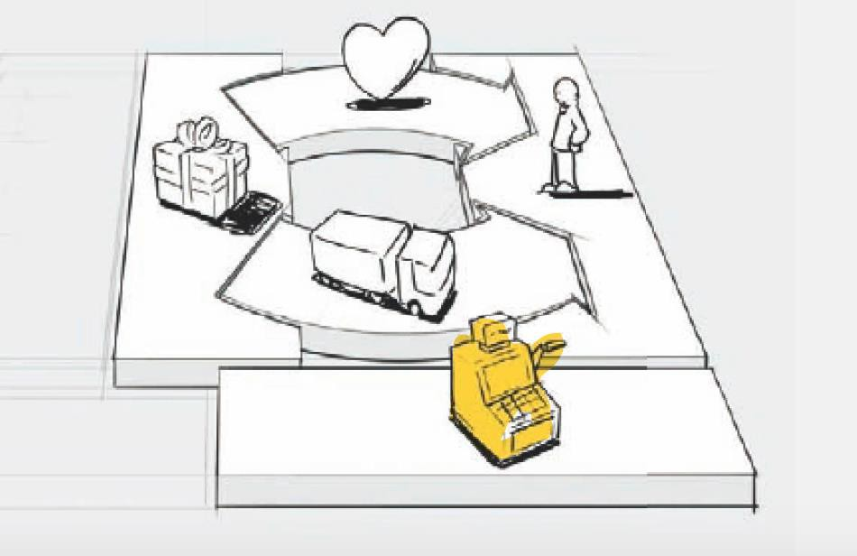
Marketing basics: First input (1)
First input for marketing is your business model; your products are designed for certain target groups

Slide 5
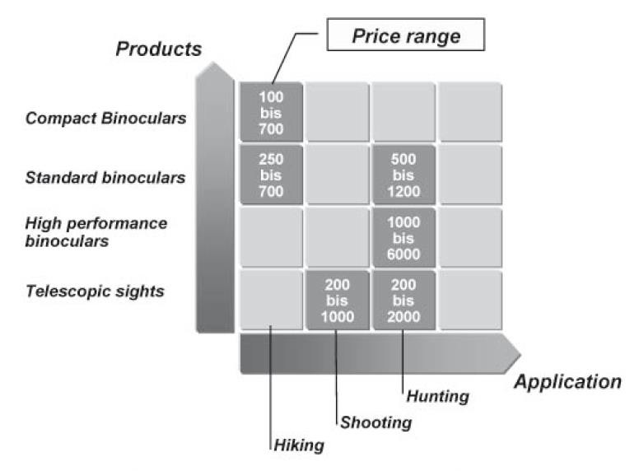
Marketing basics: First input (2)
Each target group may require a specific product variant, relationship, price, etc.
Image: Schwetje & Vaseghi (2007) The business plan.

Slide 6
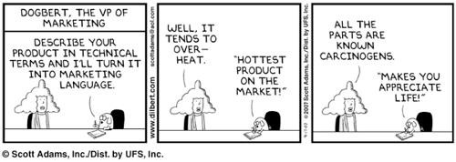
Marketing Basics
A market-focused, or customer- focused, organization first determines what its potential customers desire, and then builds the product or service

Slide 7
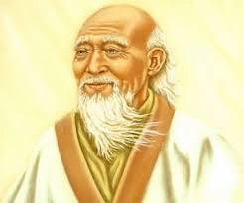
Marketing Mgmt. Philosophies
1.
2.
3.
Production Sales Marketing

Slide 8

1. Production Orientation
Focuses on internal capabilities of firm.
“Field of Dreams” strategy
“If we build it, they will come”
Best used when
competition is weak
demand exceeds supply
generic products competing solely on price
Not close enough to customer needs

Slide 9

2. Sales Orientation
People will buy more goods/services if aggressive sales techniques are used.
High sales will result in high profits.
Used with unsought products
life insurance
encyclopedias
Not close enough to customer needs

Slide 10

3. Marketing Orientation
Marketing concept:
The social and economic justification for an organization’s existence is the satisfaction
of customer wants and needs, while meeting organizational objectives.

Slide 11
3. Marketing Orientation . . .
Focusing on customer wants so the organization can distinguish its products from competitors’
Integrating all the organization’s activities, including promotion, to satisfy these wants
Achieving long term goals for the organization by satisfying customer wants and needs legally and responsibly

Slide 12
3. Marketing Orientation . . .
Requires:
Top management leadership
A customer focus
Competitor intelligence
strengths
weaknesses
Interfunctional coordination to meet customer wants/needs and deliver superior values

Slide 13
Differences between Sales & Marketing Orientations
Sales Focus
Organization’s needs
Selling goods/services
Everybody
Profit through max. sales volume
Intensive promotion
Marketing Focus
Customer’s needs
Satisfying customer wants/needs
Specific groups of people
Profit through customer satisfaction
Coordinated mktg. activities (4 p’s)

Slide 14
Relationship Marketing
Forging long-term partnerships with customers and contributing to their success.
Companies benefit from
repeat sales/referrals that lead to increases in sales, market share and profits, and
decreased costs - it’s less expensive to serve existing customers than attract new ones.

Slide 15


Relationship Marketing
Keeping a customer costs 1/4 of what it costs to attract new customer.
Probability of keeping current customer = 60%.
Probability of gaining new customer < 30%.

Slide 16

Relationship Marketing
Customers benefit from:
stable relationships with suppliers (especially in business-to-business)
greater value and satisfaction
discounts, perks (frequent flyer programs,
shopper clubs, etc.)
sense of well-being/bonding (doctor, hair stylist, etc.)

Slide 17
Relationship Marketing
Successful relationship marketers have:
customer-oriented personnel
effective training programs
employees with authority to make decisions and solve problems
teamwork

Slide 18
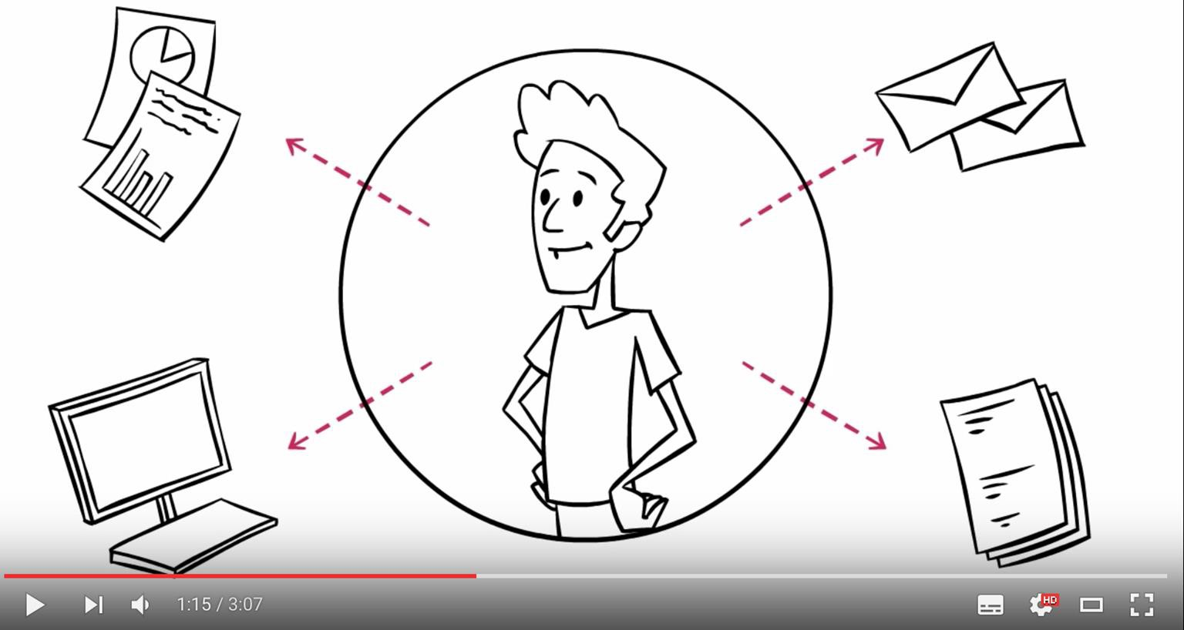
Relationship Marketing
Today's customers want to feel valued and listened to; they want personalised experiences.

Slide 19
The Marketing Process
Understand the organisation’s mission & the role marketing plays in fulfilling that mission
Set the marketing objectives
Gather, analyze and interpret the
organisation’s situation - “SWOT” analysis.
Strengths
Weaknesses
Opportunities
Threats

Slide 20
The Marketing Process . . .
Develop marketing strategy
target market
marketing mix
Implement marketing strategy.
Evaluate performance measures.
Periodically evaluate marketing efforts and make changes, if needed.

Slide 21
The Four Ps
Four Ps
Product
Pricing
Placement
Promotion
(People, Process)

Slide 22
Product
The product or services offered by the company that meet the requirements of the customers.
How many?
How many features per product?

Slide 23

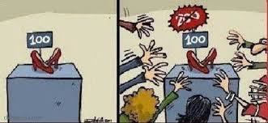
Pricing
The process of setting the prices for the products /
services
How to determine your product’s price?
You want to maximize profits
You want to be cheaper than the competition (maybe?)
Objectives:
Definite sales volume
Achieve profit
Larger market share
Maintain market share
Eliminate competition
Advantages of mass production
Satisfactory return on capital

Slide 24
Pricing:
Determining the Price
Production and distribution costs
Substitute goods available
Normal trade practices
Fixed prices
Reaction of distributors
Reaction of consumers
Nature of demand:
Elastic
Inelastic

Slide 25
Pricing:
Determining the Price
Form of market:
Perfect competition
Monopolistic competition
Monopoly
Oligopoly
https://youtu.be/0Gb4t1L2MH0

Slide 26
Pricing:
Three main models to consider
Three models
Billing by the hour
Subscription based
One time sales price

Slide 27

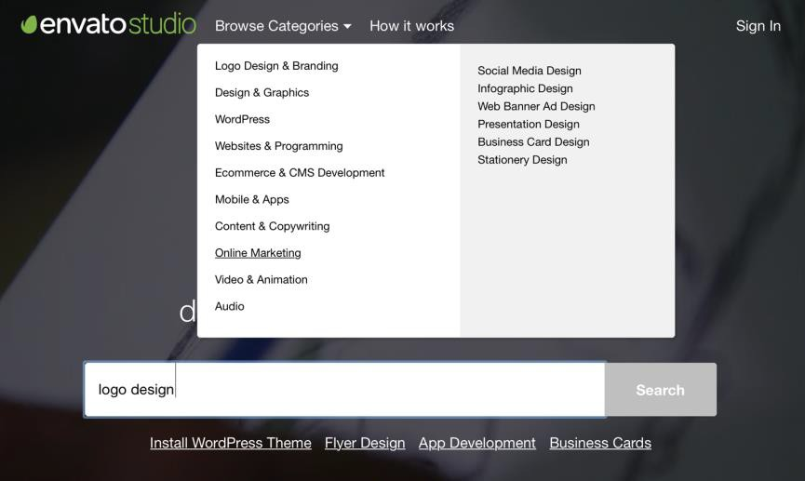
Three main models:
Billing by the hour
Uurtje Factuurtje
Direct return and profitable (+)
Customers do not know how expensive the total is going to be (-)
tip: https://studio.envato.com

Slide 28

Three main models: Subscription Based
Great for long term
Cumulative income (+)
Easy to calculate each year (+)
Short term liquidity problems, takes at least two years before breaking even per customer (-)

Slide 29

Three main models: One Time Sales Price
One time sales price plus maintenance
Great for liquidity
Every year you need more customers, unable to predict revenue

Slide 30
Pricing:
Software Company X
Recently switched to subscription based price
Used to offer its product for 800 plus 150 maintenance per year
Competition sold product for 480 per year (a hard sell!)
Now switched to subscription based, cannot convince the old customers, uses version II of its product

Slide 31
Pricing:
Many more SaaS pricing schemes
Subscription
Monthly fee per seat: Freshdesk https://freshdesk.com/pricing
Freemium strategy: Dropbox https://www.dropbox.com/business
Spotify https://www.spotify.com/uk/premium/?checkout=false
Transaction based pricing (like credit cards)
Per units of transaction: Tata Consulting
http://www.tcs.com/SiteCollectionDocuments/White%20Papers/Transaction-Based-Pricing-1014-1.pdf
Per ranges: DigitaleFactuur https://www.digitalefactuur.nl/prijzen--aanmelden
Ad-based revenue (e.g. pay per click)
Google, Yahoo!, YouTube, Spotify
Selling data
– LinkedIn, Google
Note that there are mixed models (e.g. Spotify mixes freemium with ad-based).

Slide 32

Placement
It refers to the geographical areas to sell and the channels selected to reach the market.
Many options:
Manufacturer to consumer (most direct)
Manufacturer to wholesaler to retailer to consumer (traditional)
Manufacturer to agent to retailer to consumer (current)
Manufacturer to agent to wholesaler to
retailer to consumer
Manufacturer to agent to customer

Slide 33
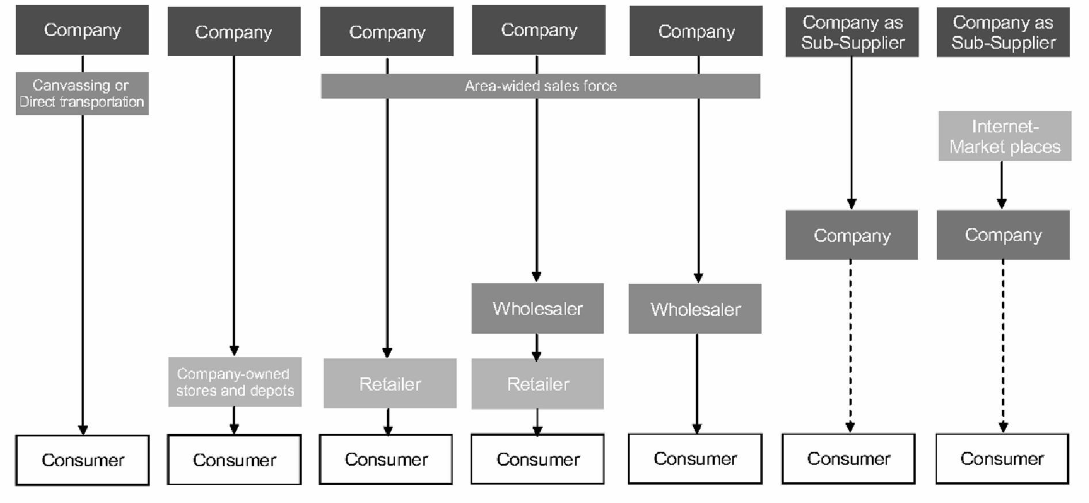
Placement
Many options:
Image: Schwetje & Vaseghi (2007) The business plan.

Slide 34

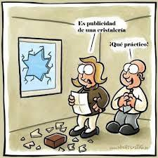
Promotion
Includes the tools used by marketers to make potential customers aware of products / services and the benefits of
buying them
It’s publicity from a glassware shop.
How convenient!

Slide 35
Promotion
Eight steps in an advertising campaign
Market research
Setting out aims
Budgeting
Choice of media
Choice of actors
Design and wording
Coordination
Test results

Slide 36

Ethical marketing
Deontology
code of conduct for marketers
business ethics
E.g. Ethical norms of the AMA:
As Marketers, we must:
Do no harm
Foster trust in the marketing system
Embrace ethical values
https://bit.ly/2URrs3v

Slide 37
Ethical marketing
E.g. Ethical values of the AM
Honesty – to be forthright in dealings with customers and stakeholders.
Responsibility – to accept the consequences of our marketing decisions and strategies.
Fairness – to balance justly the needs of the buyer
with the interests of the seller.
Respect – to acknowledge the basic human dignity of all stakeholders.
Transparency – to create a spirit of openness in marketing operations.
Citizenship – to fulfill the economic, legal, philanthropic and societal responsibilities that serve stakeholders.
https://bit.ly/2URrs3v
A:

Slide 38
Ethical marketing
Types of Unethical Advertising
Surrogate Advertising – In certain places there are laws against advertising products like cigarettes or alcohol. Surrogate advertising finds ways to remind consumers of these products without referencing them directly.
Exaggeration – Some advertisers use false claims about a product's quality or popularity. A Slogan like “get coverage everywhere on earth” advertises features that cannot be delivered.
Puffery – When an advertiser relies on subjective rather than objective claims, they are puffing up their products. Statements like “the best-tasting coffee” cannot be confirmed objectively.
Unverified Claims – Many products promise to deliver results without providing any scientific evidence. Shampoo commercials that promise stronger, shinier hair do so without telling consumers why or how.
http://www.marketing-schools.org/types-of-marketing/ethical-marketing.html

Slide 39
Ethical marketing
Types of Unethical Advertising
Stereotyping Women – Women in advertising have often been portrayed as sex objects or domestic servants. This type of advertising traffics in negative stereotypes and contributes to a sexist culture.
False brand comparisons – Any time a company makes false or misleading claims about their competitors they are spreading misinformation.
Children in advertising – Children consume huge amounts of advertising without being able to evaluate it objectively. Exploiting this innocence is one of the most common unethical marketing practices.
http://www.marketing-schools.org/types-of-marketing/ethical-marketing.html

Slide 40
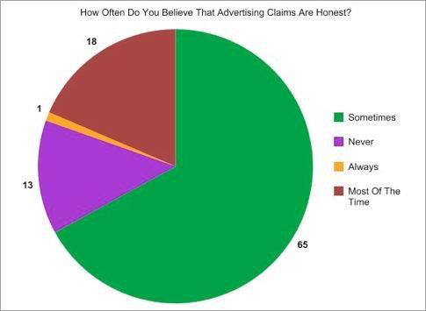
Ethical marketing
http://www.marketing-schools.org/types-of-marketing/ethical-marketing.html

Slide 41

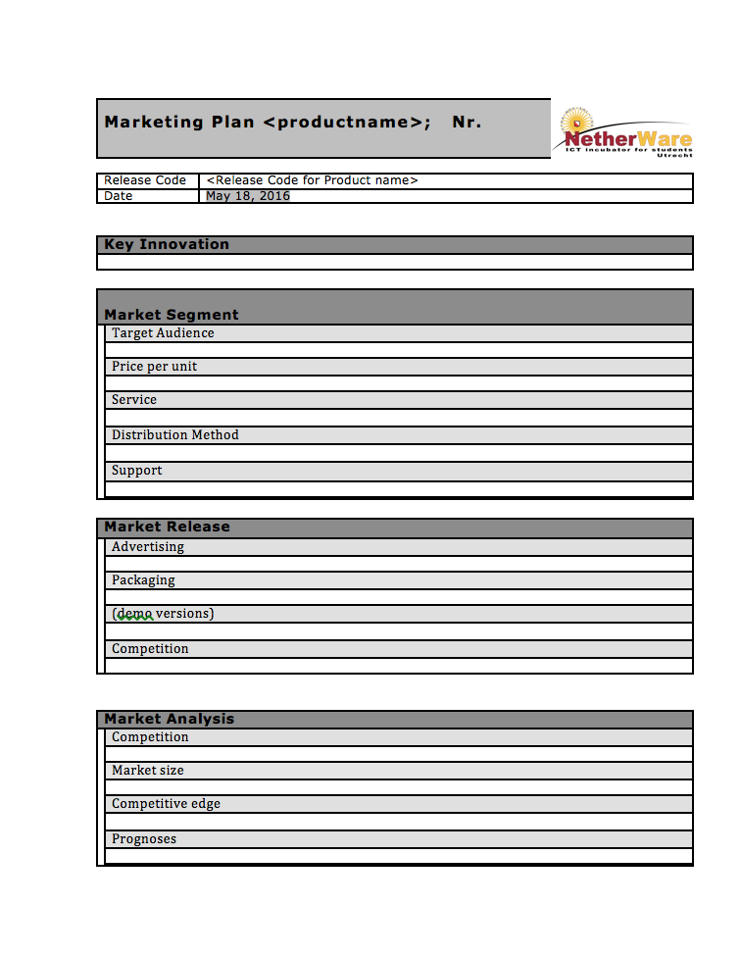
Marketing plan
Put everything together!

Slide 42
Assignment
Draw up a marketing plan & validate it; use 4 P’s!
Potential validation methods are
Literature review
Focus group, survey or interviews
Customer expression of interest
Market research
Feedback collection during showcasing, a conference or an entrepreneurial event
Expert assessment

